Slide 1
Session 05 Interface and Inheritance (https://docs.oracle.com/javase/tutorial/java/IandI/)

Slide 2
Objectives
Benefits of OO implementation: Inheriatnce, Polymorphism
Working with Interfaces.
Working with Abstract Methods and Classes.
Anonymous Classes
Enum Type
Practice walkthroughs
Notes:
Interface:
Hardware interface: Cổng giao tiếp
Software interface: Thư viện lập trình
OO: Khai báo tập hợp các hành vi
VD: Cái tên Java OOP là Interface, người dạy Java là người hiện thực Implement

Slide 3
Implementing Object-Oriented Relationships
3 common relations in classes:
“is a/ a kind of”
“has a”
association
Examples:
Student is a person
“A home is a house that has a family and a pet.”
An invoice contains some products and a product can be contained in some invoices

Slide 4
Implementing Object-Oriented Relationships…
The relation “is a” is implemented as a sub-class
Person
String name, address String birthDate
+ String getName(); + void setName(String n);
…….
The relation “has a” is implemented as reference
Classes Professor, Student are sub-classes of the class Person
Sub-classes inherit the structure of super class
is a
is a
Professor
String department
+ String getDepartment(); + void setDepartment(String d);
Student
String studentId, majorField String degreeSought
+ String getStudentId(); + void setStudentID(String id)
….
teach
The class Professor has the field Student[] students
The class Student has the field Professor pr

Slide 5
Inheritance
There are some sub-classes from one super class ➔ An inheritance is a relationship where objects share a common structure: the structure of one object is a sub-structure of another object.
The extends keyword is used to create sub-class.
A class can be directly derived from only one class ( Java is a single-inherited OOP language).
If a class does not have any superclass, then it is implicitly derived from Object class.
Unlike other members, constructor cannot be inherited ( constructor of super class can not initialize sub-class objects)

Slide 6
Inheritance…
How to construct a class hierarchy? → Intersection
Electric Products< code, name, make, price, guaranty, voltage, power>
Ceramic Products < code, name, make, price, type >
Food Products < code, name, make, price , date, expiredDate >
Product
code
name
make
price
ElectricProduct
Ceramic
Food
guaranty
voltage
power
type
date
expiredDate
Notes:
ElectricProduct “Is A” Product
Ceramic “Is A” Product

Slide 7
Inheritance…: “super” Keyword
Constructors Are Not Inherited
super(...) for Constructor Reuse
super(arguments); //invoke a superclass constructor
The call must be the first statement in the subclass constructor
Replacing the Default Parameterless Constructor
Notes:
always explicitly program a parameterless constructor for a class X any time you program any explicit constructor for class X, to replace the “lost” default constructor.

Slide 8
Inheritance…: “super” Keyword
We use the Java keyword super as the qualifier for a method call: super. methodName(arguments);
Whenever we wish to invoke the version of method methodName that was defined by our superclass.
super() is used to access the superclass's constructor. And It must be the first statement in the constructor of the subclass.

Slide 9
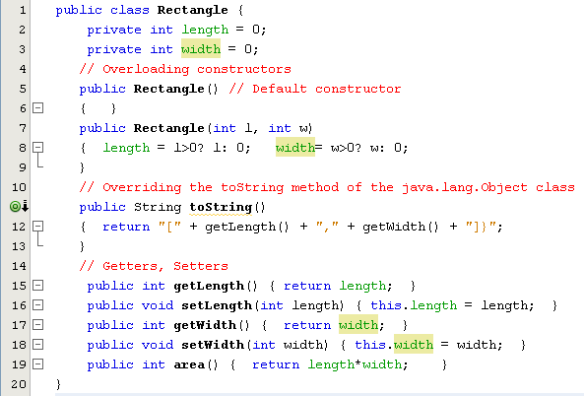
Inheritance…

Slide 10
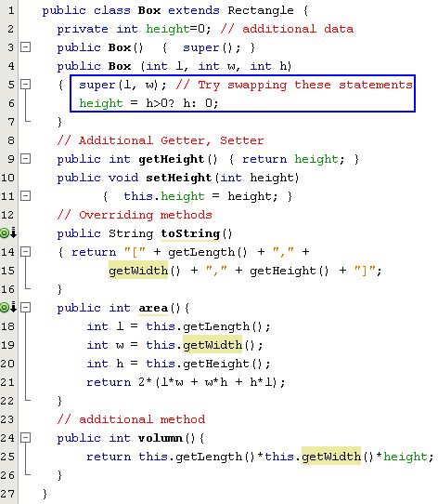
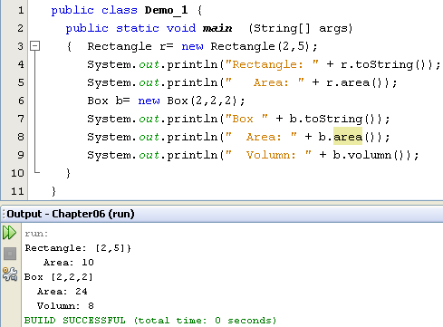
Inheritance…

Slide 11
Overriding and Hiding Methods (1)
Overriding a method: An instance method in a subclass with the same signature (name, plus the number and the type of its parameters) and return type as an instance method in the superclass overrides the superclass's method.
Use the @Override annotation that instructs the compiler that you intend to override a method in the superclass (you may not use it because overriding is default in Java).
Hiding a method: Re-implementing a static method implemented in super class
Notes:
Annotation: chú dẫn

Slide 12
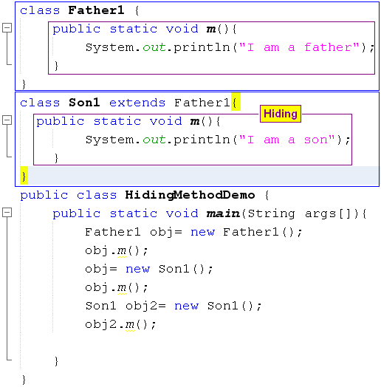

Overriding and Hiding Methods (2)

Slide 13
Polymorphism
The ability of two or more objects belonging to different classes to respond to exactly the same message (method call) in different class-specific ways.
Inheritance combined with overriding facilitates polymorphism.
Notes:
Overiding cho ra: Tính đa hình thực sự.

Slide 14
Polymorphism…)
Student
String name;
+ void print();
GraduateStudent
String underGraduateDegree;
+ GraduateStudent(String n, String ug) + void print();
UndergraduateStudent
String highSchool;
+ UndergraduateStudent(String n, String h) + void print ();

Slide 15
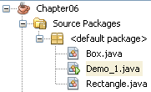
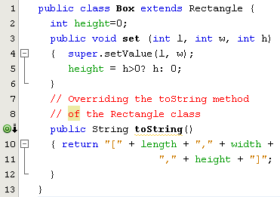
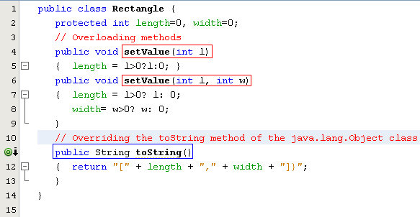

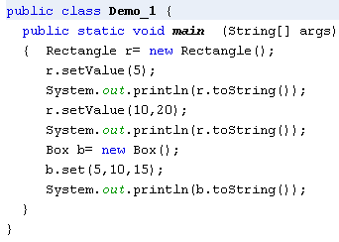
Overriding Inherited Methods
Overridden method: An inherited method is re-written
Overloaded methods: Methods have the same name but their parameters are different in a class

Slide 16
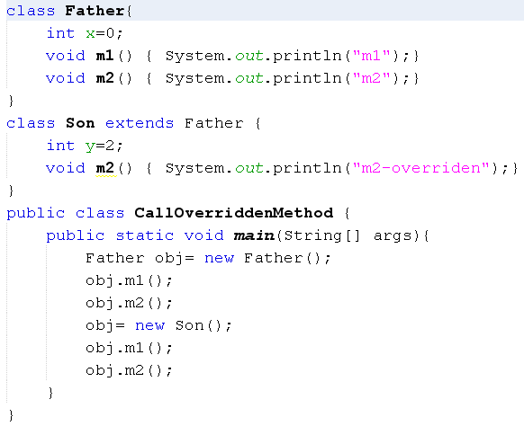
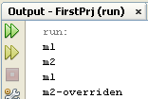
How Can Overridden Method be Determined?

Slide 17
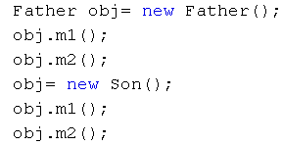
How Can Overridden Methods be Determined?
Son(declaration)
int y=2
Method Table
(m1, 600)
(m2, 800)
800
m2()
700
Father(declaration)
int x=0
Method Table
(m1, 600)
(m2, 650)
Class: 700
Class: 500
y=2
8000
x=0
9000
x=0
650
m2()
600
m1()
obj: 8000
obj: 9000
500
obj.m1();
obj.m2();
obj.m1();
obj.m2();
Classes are loaded to static heap

Slide 18
Interfaces
An interface is a reference type, similar to a class, that can contain only constants, initialized fields, static methods, prototypes (abstract methods, default methods → Hành vi mức đối tượng nhưng chưa được thực hiện), and nested types.
It will be the core of some classes
Interfaces cannot be instantiated because they have no-body methods.
Interfaces can only be implemented by classes or extended by other interfaces.

Slide 19
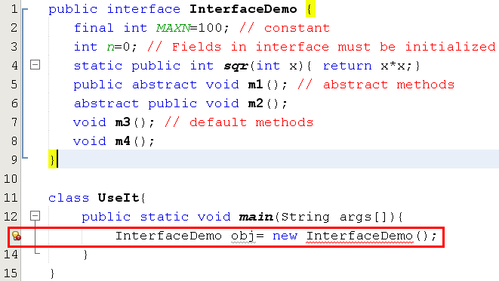
Interfaces…

Slide 20
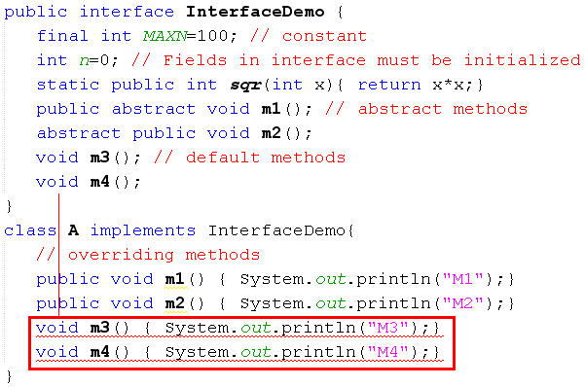
Interfaces…
m3(), m4() in A cannot implement m3(), m4() in InterfaceDemo, attempting to assign weaker access privileges, were public
Default methods of an interface must be overridden as public methods in concrete classes.

Slide 21
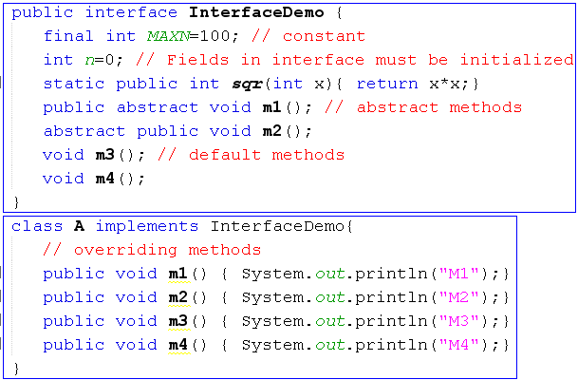
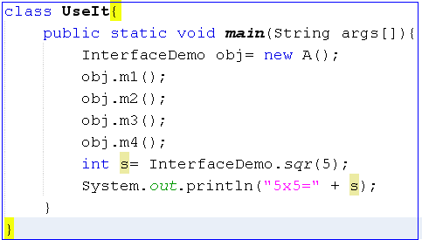
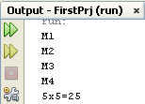
Interfaces…

Slide 22
Abstract Classes
Used to define what behaviors a class is required to perform without having to provide an explicit implementation.
It is the result of so-high generalization
Syntax to define a abstract class
public abstract class className{ ... }
It isn’t necessary for all of the methods in an abstract class to be abstract.
An abstract class can also declare implemented methods.

Slide 23
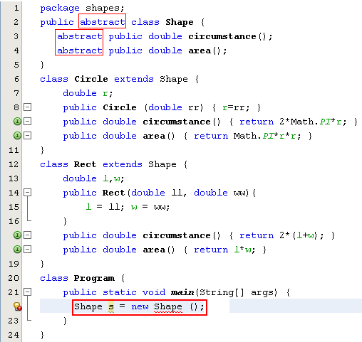
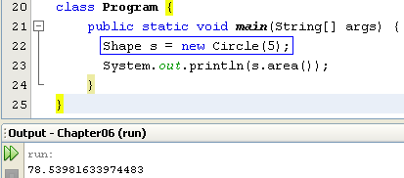
Abstract Classes…
Modified

Slide 24
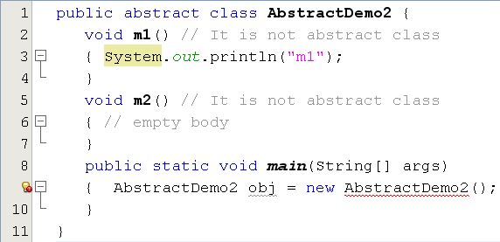
Abstract Classes…
This class have no abstract method but it is declared as an abstract class. So, we can not initiate an object of this class.

Slide 25
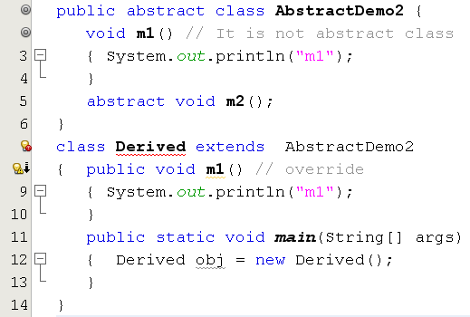
Abstract Classes…
Error. Why?
Notes:
Derieved trong hình đang “bị trừu tượng” do là con của AbstractDemo2, hành vi m2() chưa được thực hiện.

Slide 26
Implementing Abstract Methods
Derive a class from an abstract superclass, the subclass will inherit all of the superclass’s features, all of abstract methods included.
To replace an inherited abstract method with a concrete version, the subclass need merely override it.
Abstract classes cannot be instantiated

Slide 27
Anonymous Classes
Anonymous classes are classes which are not named but they are identified automatically by Java compiler.
Where are they? They are identified at initializations of interface/abstract class object but abstract methods are implemented as attachments.
Why are they used?
Enable you to make your code more concise.
Enable you to declare and instantiate a class at the same time.
They are like local classes except that they do not have a name.
Use them if you need to use a local class only once.

Slide 28
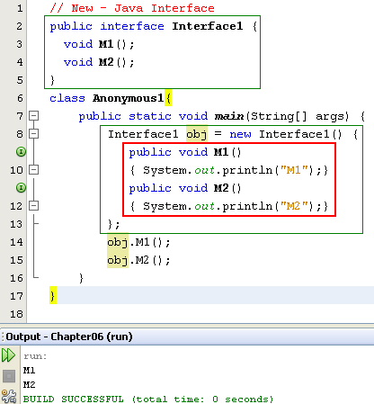

Anonymous Class…
Anonymous class.
Class name is given by the compiler:
ContainerClass$Number

Slide 29
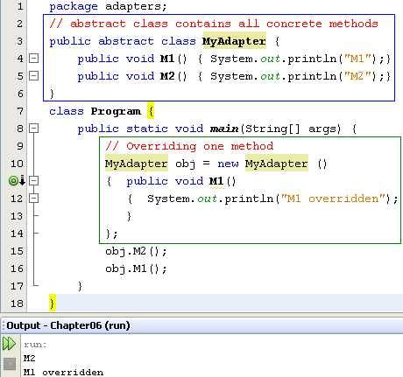
Anonymous Class…
Concrete methods but they can not be used because the class is declared as abstract one.
The abstract class can be used only when at least one of it’s methods is overridden
Anonymous class is a technique is commonly used to support programmer when only some methods are overridden only especially in event programming.

Slide 30

Enum Types (1)
An enum type is a special data type that enables for a variable to be a set of predefined constants.
We use enum types any time you need to represent a fixed set of named-constants (uppercase).
New/ Java Enum

Slide 31
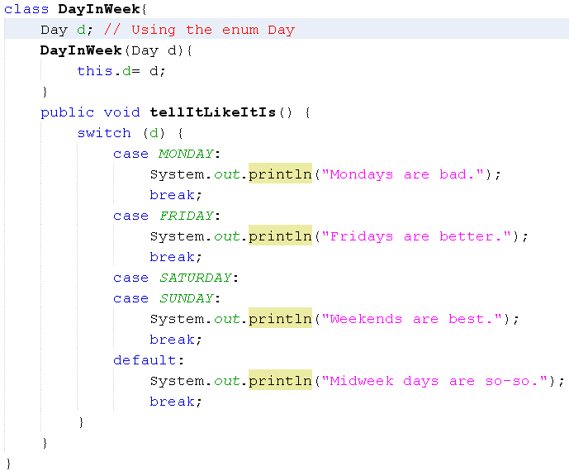
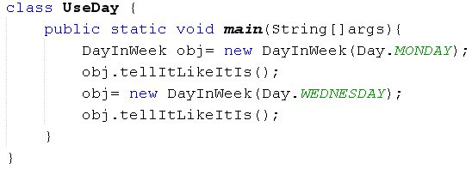

Enum Types (2)

Slide 32
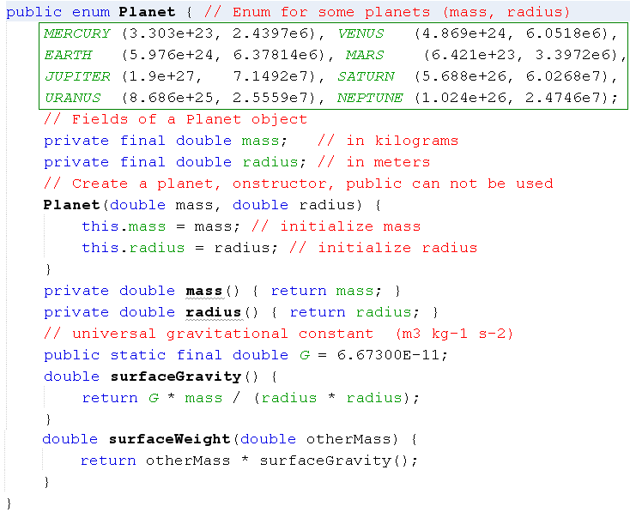
Enum Types (3)

Slide 33
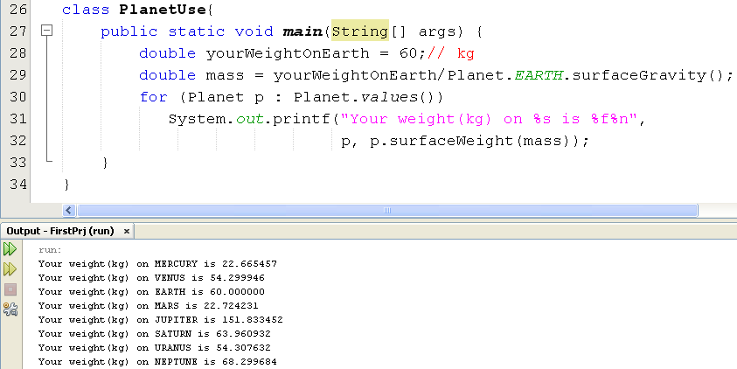
Enum Types (4)

Slide 34
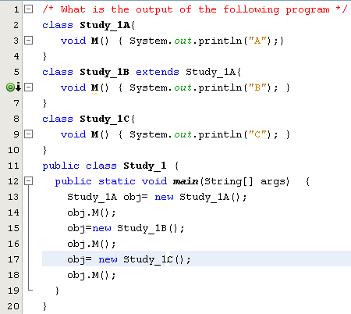
Test
a) ABC
b) AAC
c) ABA
d) Compile-time error
Study_1A and Study_1C are inconvertible

Slide 35
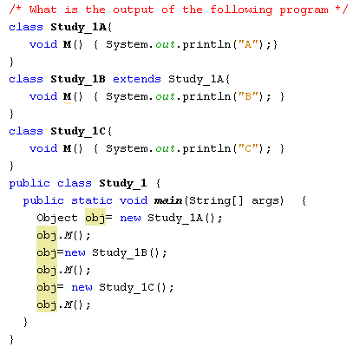
Test
a) ABC
b) AAC
c) ABA
d) Compile-time error
The java.lang.Object class does not have the M() method

Slide 36
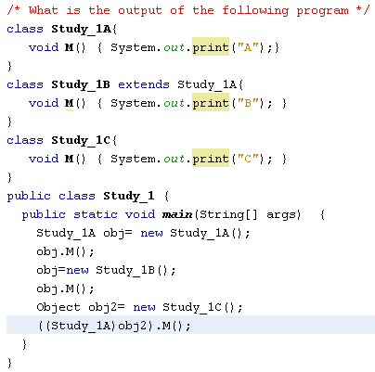
Test
a) ABC
b) AAA
c) ABA
d) None of the others
AB and a ClassCastException

Slide 37
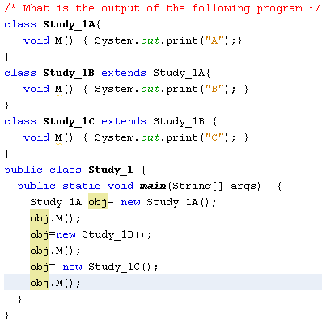
Test
a) AAA
b) ACB
c) None of the others
d) ABC

Slide 38
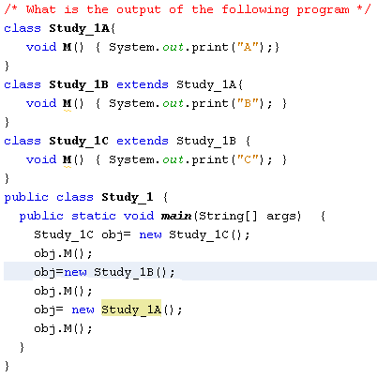
Test
a) ABC
b) AAA
c) ABA
d) None of the others
Compile-time error
( Type conformity violation)

Slide 39
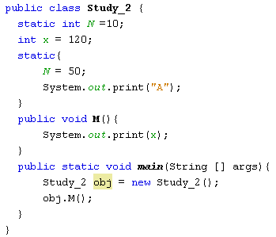
Test
a) 120
b) 120A
c) None of the others
d) A120

Slide 40
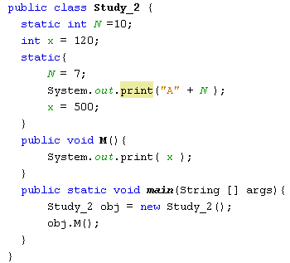
Test
a) A7500
b) 500A7
c) 500
d) None of the others
Compile-time error
( static code can not access instance variables)

Slide 41
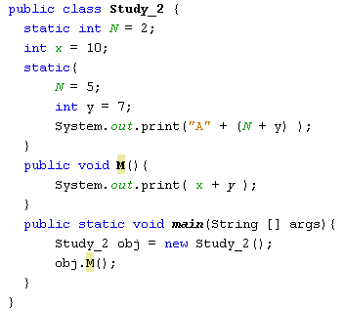
Test
a) A1210
b) 10A12
c) 17
d) None of the others
Compile-time error
( The y variable is out of scope)

Slide 42
Summary
Benefits of OO implementation: Inheriatance ans Polymorphism
Working with Interfaces.
Working with Abstract Methods and Classes.
Anonymous Classes
Enum Type

